Slide 1
Briefly describe how permutation importance is quantified, give some examples of how you would use it in machine learning projects, and the disadvantages of this method?
What is the difference between intrinsic interpretability and post-hoc interpretability? Can you think of one example of an intrinsically interpretable ML model? Can you think of some situations where you would rather use an intrinsically interpretable model that is less accurate than complex ML models (e.g., ANNs)
Describe the basic concept behind saliency maps. Why do we say that it is a pixel attribution map? What are the challenges you may face when you are using these maps to explain CNNs.

Slide 2


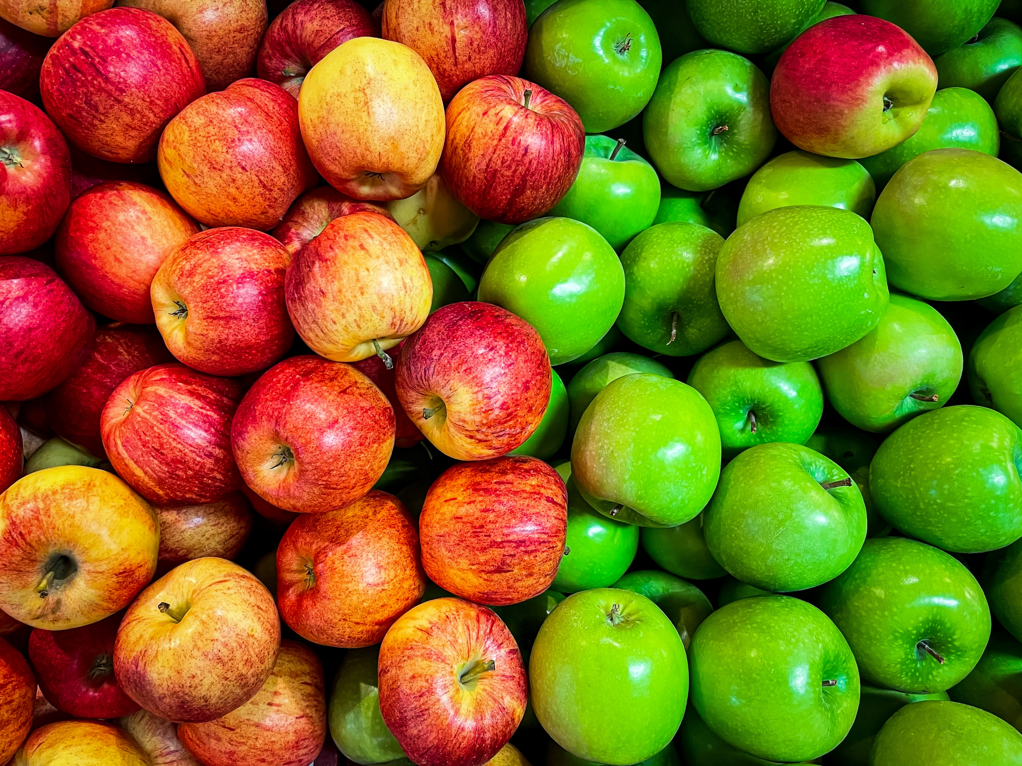
Min 60-75: Break

Slide 3


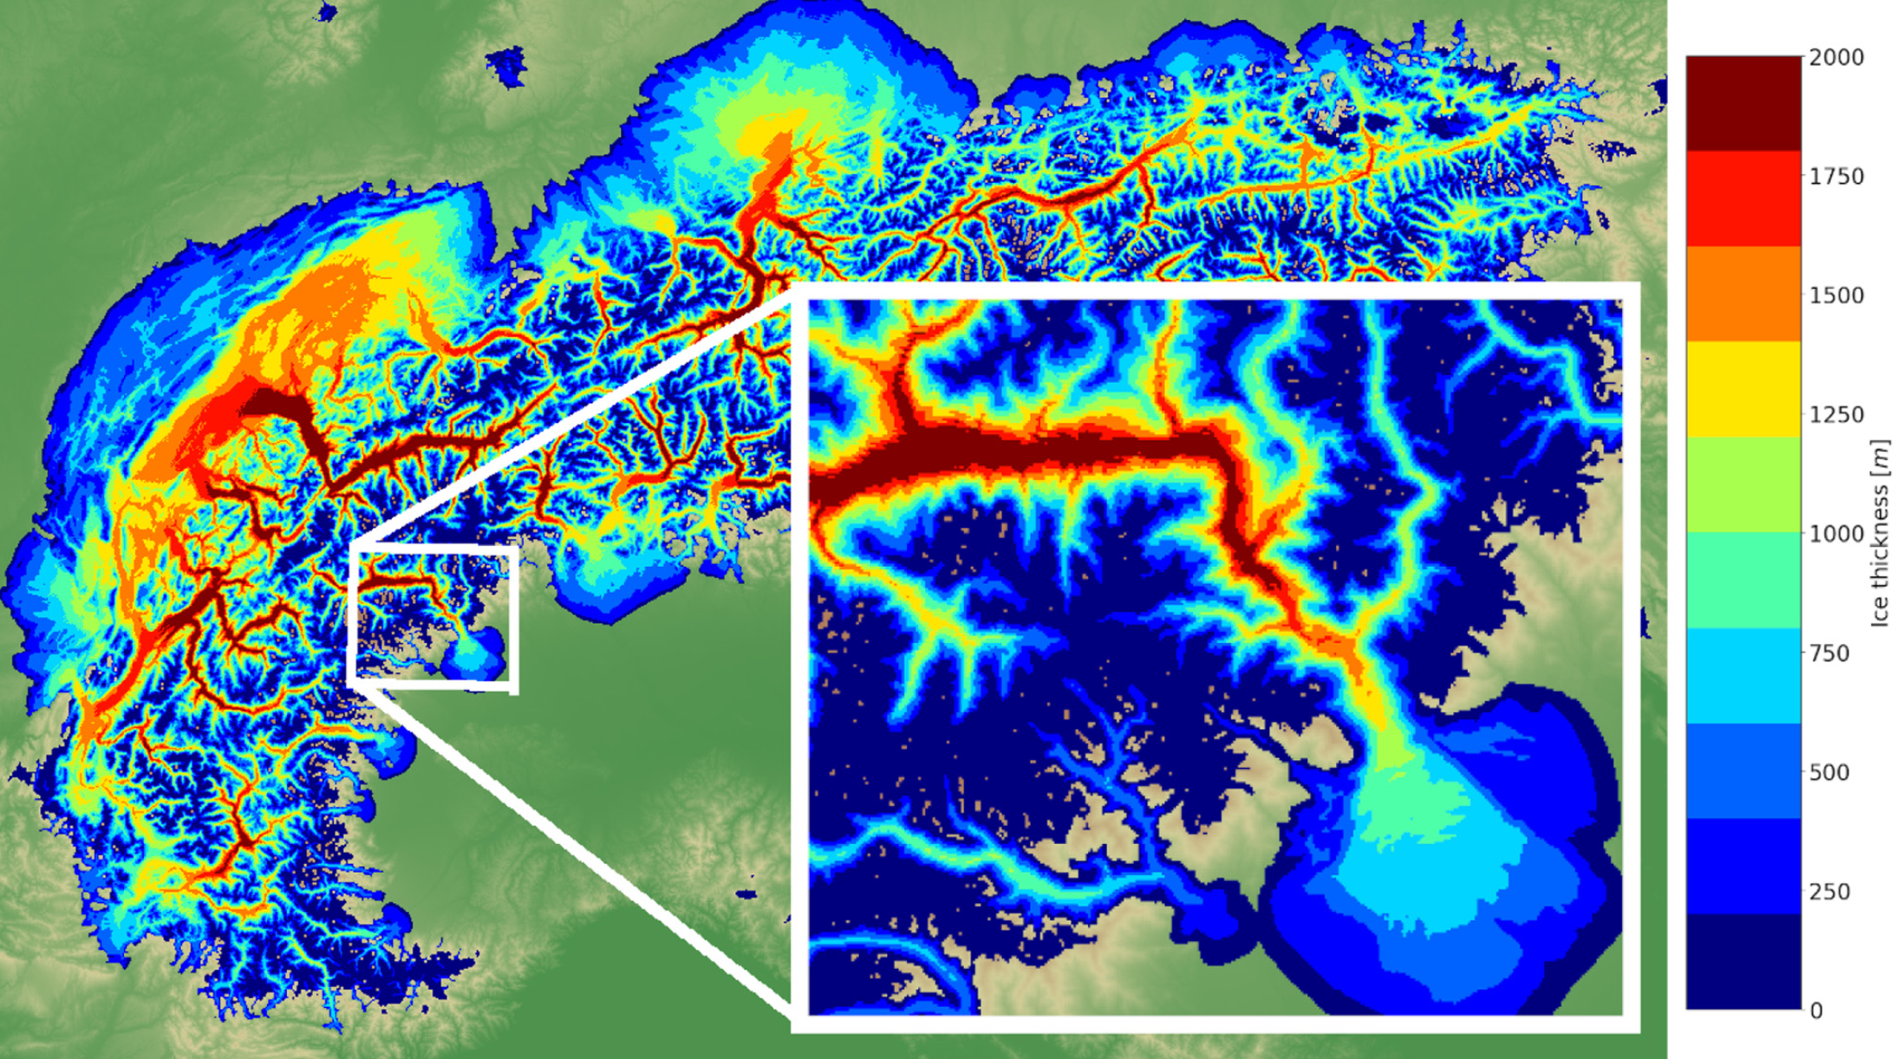
ML for Earth & Env Sci (Week 10, FA2024)
How to combine the flexibility of data-driven modeling with robust knowledge?
Ice thickness of the alpine ice field obtained at 24k YBP modelled with a physics-guided CNN at 200m of resolution Source: Jouvet & Cordonnier (2023)
Notes:
COSERO hydrological model

Slide 4
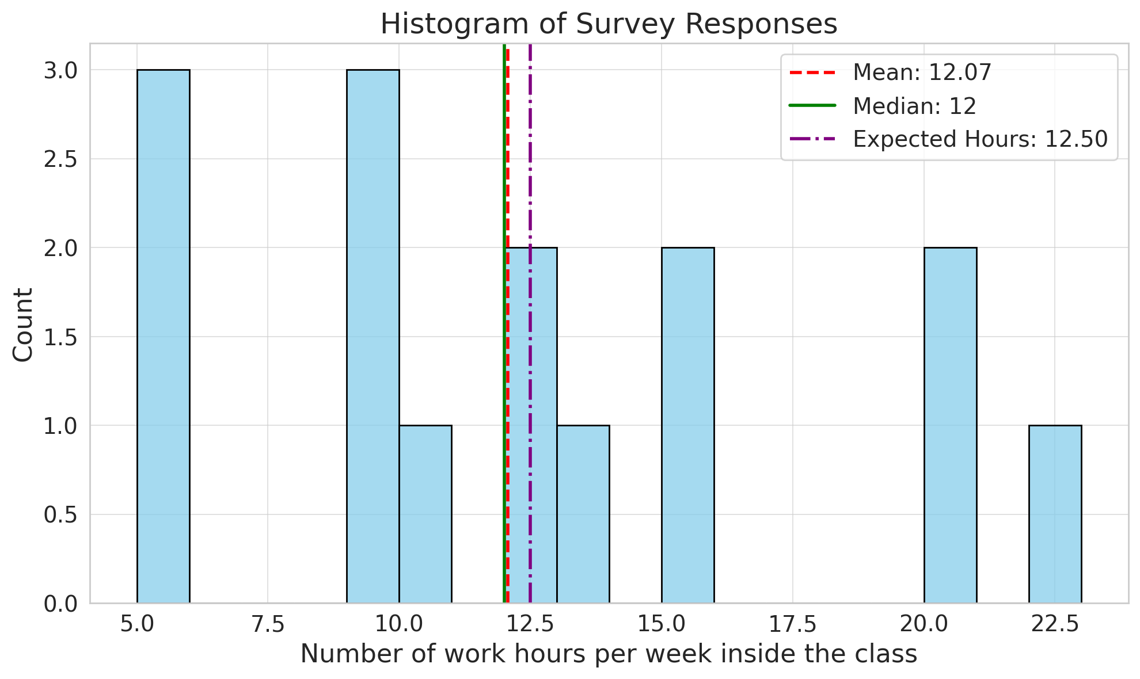

Slide 5
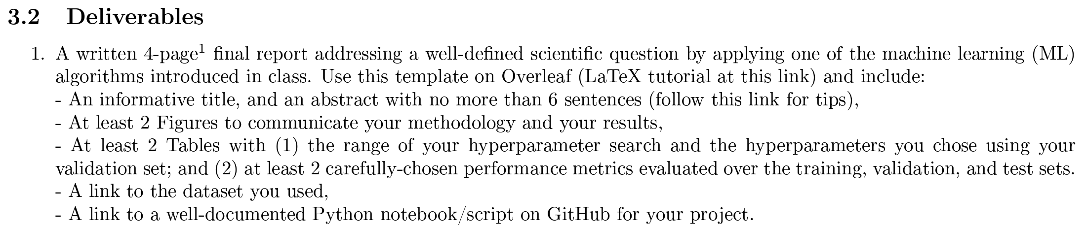
In-class Peer Review: Friday, Dec 6th, 2PM-4PM
Please use the same GitHub username as you used to fork the course’s repository
Submit first draft of your project by Thursday, Dec 5th

Slide 6
Final Presentations in room 2138 Friday, Dec 13th from 2PM to 4PM
4min presentations + 1min Q&A
Tip = 1 slide/minute
Scientific question: What’s our goal and why do we care?
Dataset: Characteristics, challenges, training/validation/test split, etc.
Methodology: Which ML algorithm(s) did you choose and why?
Results: What are your findings and how does it answer the sci. question?

Slide 7
Min 80-110: Intro. to Knowledge-Guided ML
Learning Objectives (Karpatne et al., 2022):
Understand why purely knowledge-based or data-driven models may fail
Define alignment, knowledge-guided ML, and physics-guided ML
Explain physics-guided loss functions and architectures
Distinguish hard from soft constraints
Distinguish between out-of-sample (i.i.d.) and out-of-distribution generalization
Categorize types of knowledge-guided ML

Slide 8

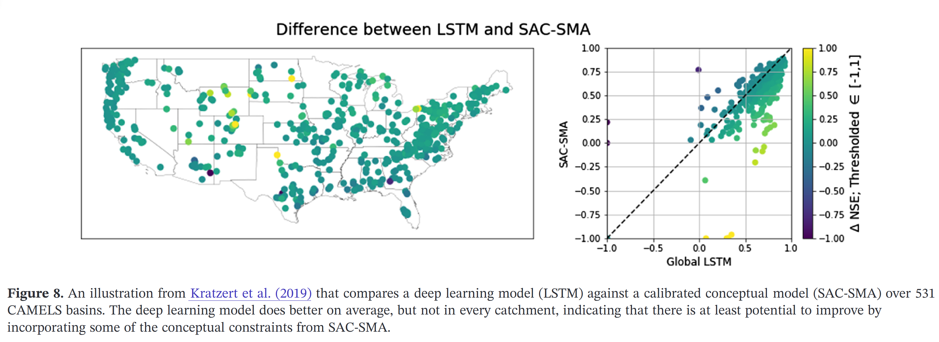
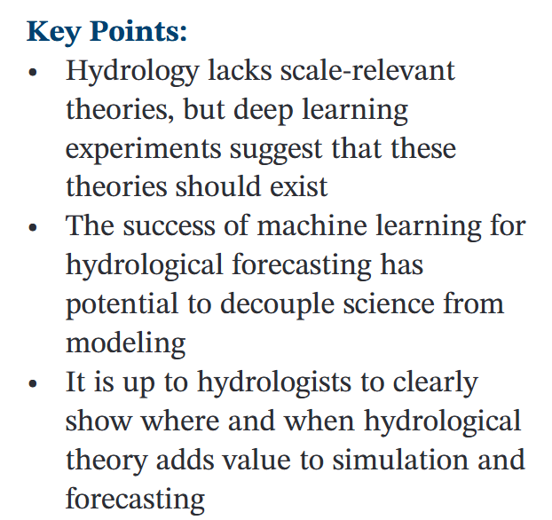
Purely knowledge-driven models may fail
Notes:
Take time to collect opinions from students. Nearing et al. (2020)

Slide 9

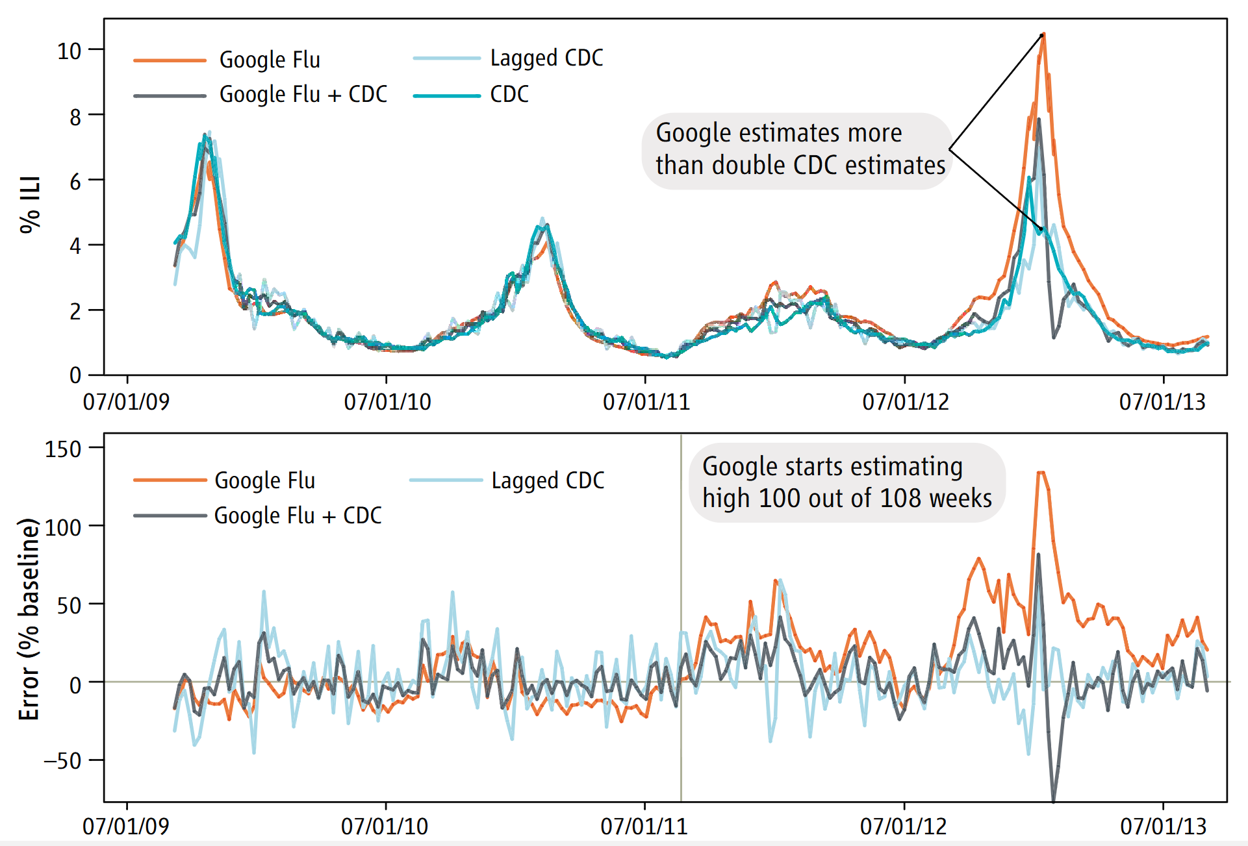
Purely data-driven models may fail: “Big data hubris”
Source: Lazer et al. (2013)
Notes:
Again poll students; GFT = Google Flu Trends; ILI = Ifluenza-like illnesses GFT overestimation. GFT overestimated the prevalence of flu in the 2012–2013 season and overshot theactual level in 2011–2012 by more than 50%. From 21 August 2011 to 1 September 2013, GFT reported overlyhigh flu prevalence 100 out of 108 weeks. (Top) Estimates of doctor visits for ILI. “Lagged CDC” incorporates52-week seasonality variables with lagged CDC data. “Google Flu + CDC” combines GFT, lagged CDC estimates,lagged error of GFT estimates, and 52-week seasonality variables. (Bottom) Error [as a percentage {[Non-CDCestmate)

Slide 10
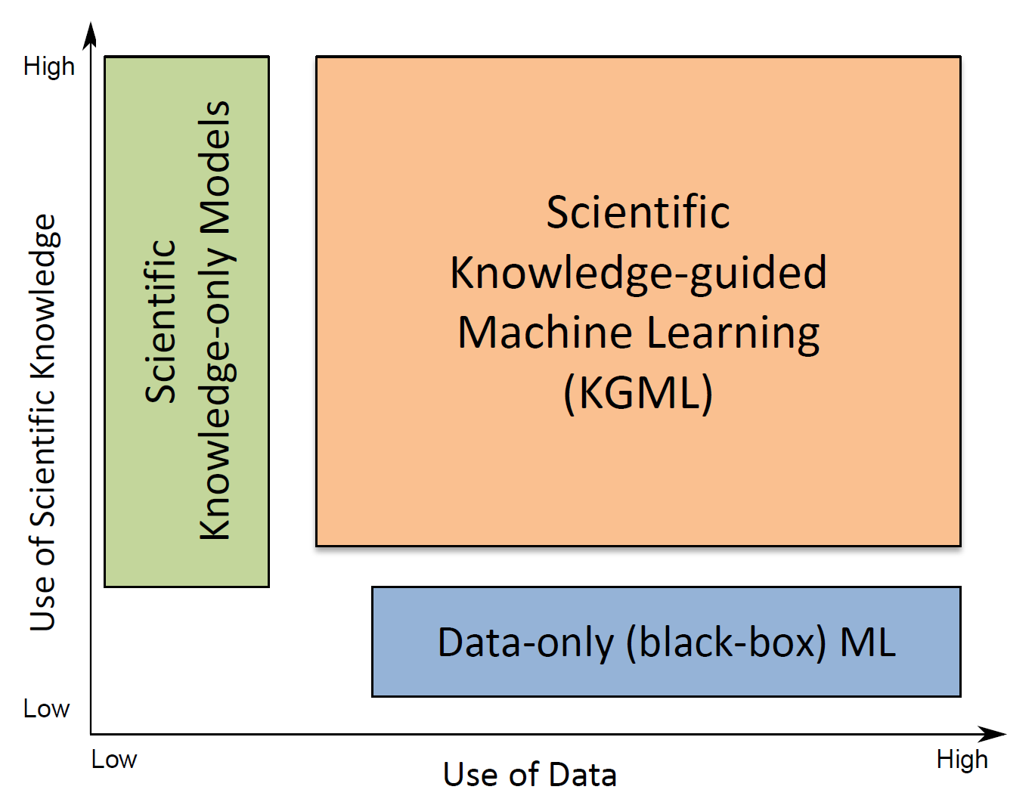
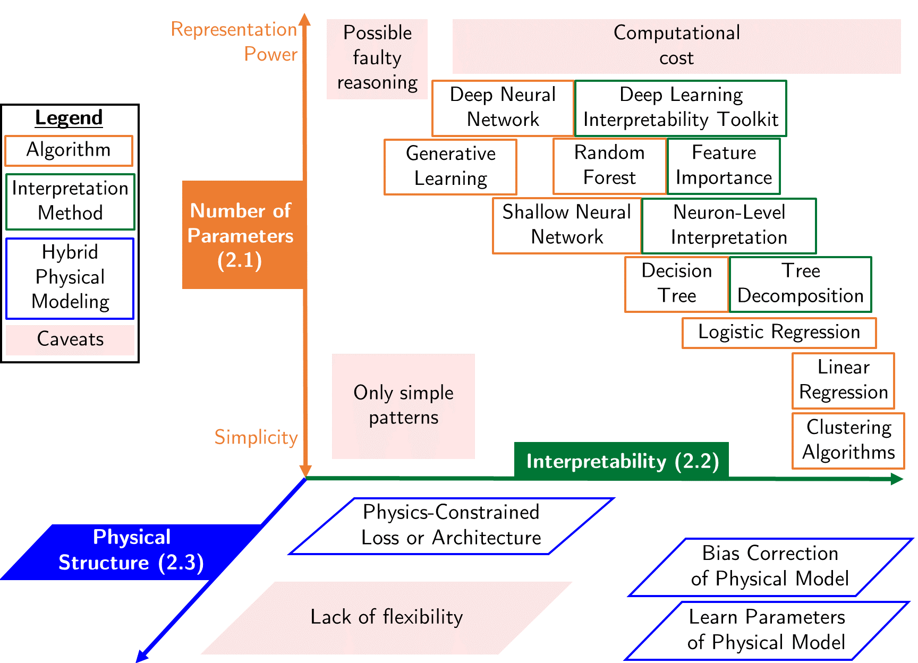
Towards the best of both worlds: Knowledge-Guided ML

Slide 11
AI Alignment, KGML, Physics-guided ML
Physics-Guided ML
KGML = Integrating knowledge into ML
Alignment = Behavior consistent with intended goals/ethics
Source: Wikipedia (AI alignment, Physics-informed neural networks)

Slide 12



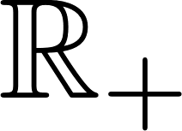
Physics-Guided ML: Add physical structure to restrict ML output to physically-plausible solutions
RH
0
1
Hard constraint: RH>0
Soft constraint: RH→1
Activation function output domain =
Physically-plausible range
Minimize ReLU( RH-1 )
Notes:
Let’s get started with *a* possible definition: Physics-Guided ML, which is a specific case of knowledge-guided ML, restricts the output of ML algorithms to plausible solutions using *physical* information. Let’s start with a simple example: [Animation 1] Imagine you are trying to predict relative humidity. As it is defined as the ratio between water vapor pressure, which is positive, and saturation vapor pressure, [Animation 2] its physically-plausible range is 0 to 1.
[Animation 3] Indeed, a negative prediction would be impossible by definition, while
[Animation 4] a prediction above 1 would correspond to super-saturation, which is rarely observed if we work on weather or climate timescales.
Therefore, we want to *always* keep relative humidity above zero, which corresponds to an [Animation 5] *hard* constraint. This hard constraint can be enforced in multiple ways, for instance by using an activation function that only outputs positive number right before predicting relative humidity. In contrast, we may temporarily tolerate values above one, and simply *discourage* the relative humidity output to be above one, which is referred to as a *soft* constraint. This soft constraint can also be enforced in multiple ways, for instance by adding a term minimizing ReLU(RH-1) in the loss function to penalize the algorithm whenever relative humidity is greater than one.

Slide 13
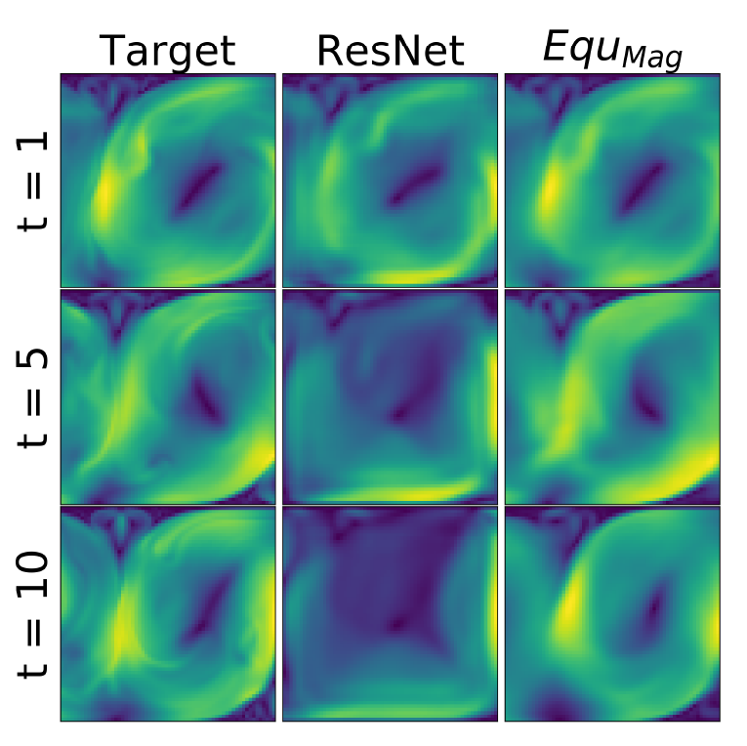
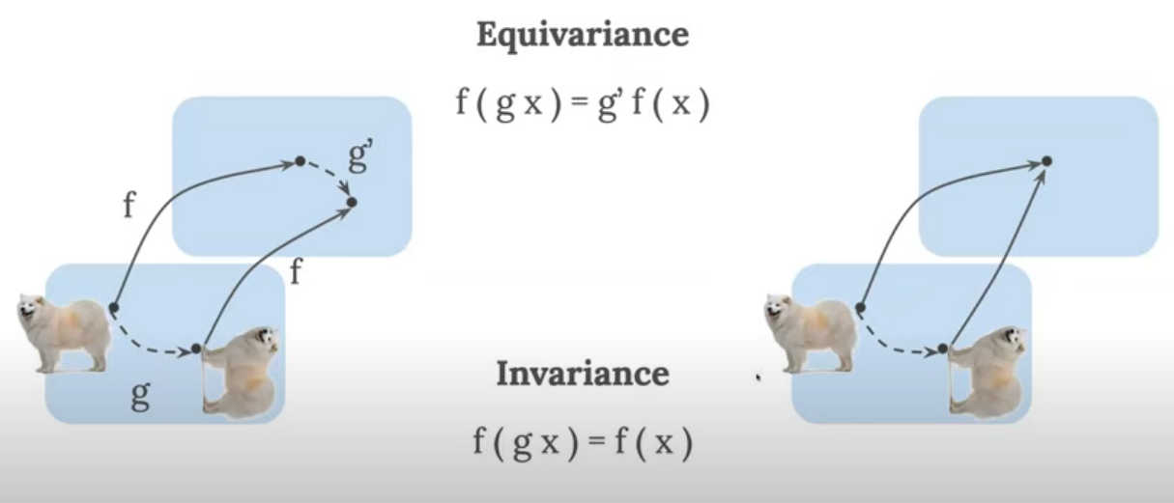
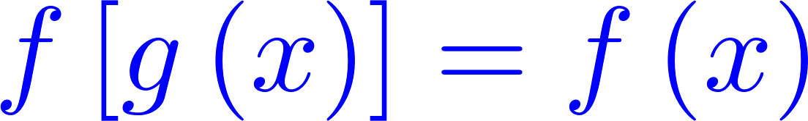
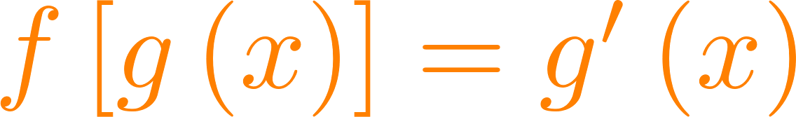
(Hard constraint) Physics-constrained architecture
Encode invariance or equivariance in architecture
Pooling layers
(large pooling size)
Convolutional layers
See: Wang et al. (2020), Image adapted from: Kobby Panford-Quainoo (2021)
Notes:
Hybrid modeling gives a plethora of creative ways to incorporate physical constraints in the architecture, starting with the encoding of invariance *or* equivariance, which can be properties of the physical system in consideration.
[Animation] Taking the simple example of a machine learning model tasked with processing the photo of a cute dog, invariance by *rotation* means that rotating the dog will not change the output of the model: for instance, the photo will still be classified as a dog picture. For convolutional neural networks that you have seen in this tier, pooling layers with large pooling sizes can almost perfectly enforce shift invariance, i.e., the output of the pooling layer is relatively insensitive to small shifts in its input image.
[Animation] By contrast, *equivariance* by rotation means that rotating the dog will rotate the output of the model: for instance, the pixels recognized as belonging to a dog will be accordingly rotated. Taking the example of convolutional neural networks, convolutional layers are shift-equivariant, as the output of convolutional layers will shift if the convolved image is shifted.
[Animation] Wang and coauthors show that enforcing *magnitude* equivariance in the architecture of a neural network tasked with integrating Rayleigh-Bénard convection forward in time significantly improves the quality of the simulation output compared to an unconstrained residual neural network architecture.

Slide 14
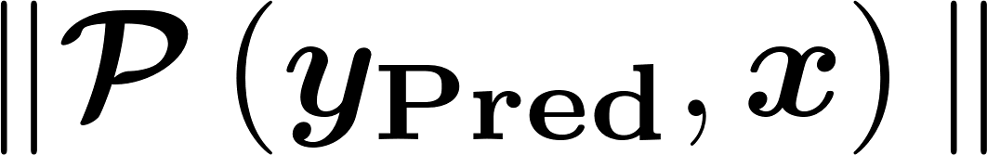
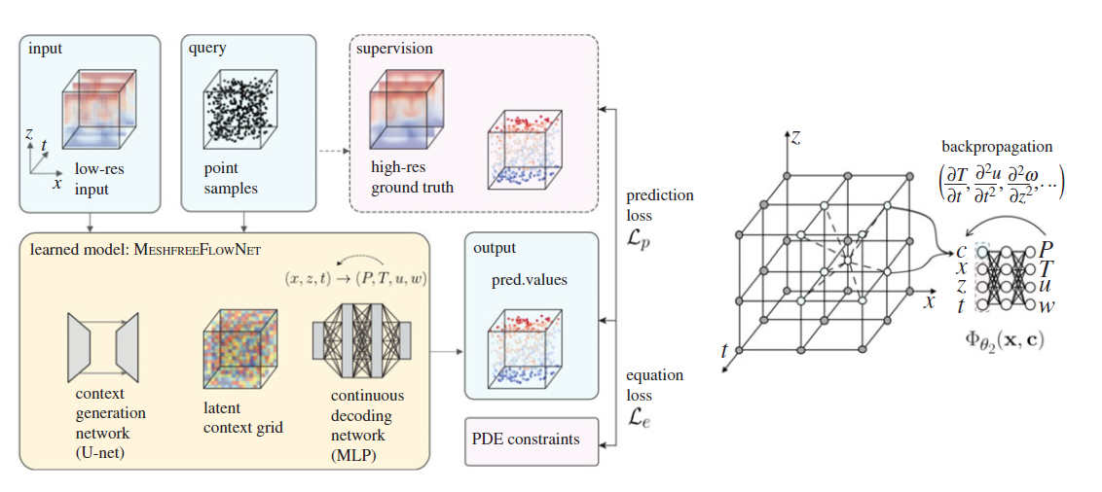
(Soft constraint) Physics-constrained loss
Physics-constrained losses:
Residual of definitions, state equations, conservation laws
Physics-Informed Neural Network
(PINN)
See: Jiang et al. (2020)
Notes:
Sometimes, constraining the model’s architecture is infeasible or overly constraining. In this case, we can encode physical information as soft constraints by adding a term to the loss function, akin to a Lagrange multiplier. So if we look at the general form of a physics-constrained loss function, it combines a term to optimize performance ,such as a standard regression loss, with a physically-constrained term. We’ll now go over several examples of which form this term can take.
[Animation] First, we can simply use the norm of the residual from definitions, state equations, or conservation laws to penalize the machine learning algorithm whenever it makes an unphysical prediction. In their proposed MeshfreeFlowNet architecture, Jiang and coauthors strategically use position and time as inputs so that any partial differential equation constraint can be efficiently calculated via automatic differentiation, which allows them to use these partial differential equations as soft constraints on the fluid flow they are simulating.

Slide 15
Physics-Guided ML: Add physical structure to restrict ML output to physically-plausible solutions
Helps with out-of-distribution generalization
RH
0
1
Hard constraint: RH>0
Soft constraint: RH→1
Activation function output domain =
Physically-plausible range
Minimize ReLU( RH-1 )
Notes:
Let’s get started with *a* possible definition: Physics-Guided ML, which is a specific case of knowledge-guided ML, restricts the output of ML algorithms to plausible solutions using *physical* information. Let’s start with a simple example: [Animation 1] Imagine you are trying to predict relative humidity. As it is defined as the ratio between water vapor pressure, which is positive, and saturation vapor pressure, [Animation 2] its physically-plausible range is 0 to 1.
[Animation 3] Indeed, a negative prediction would be impossible by definition, while
[Animation 4] a prediction above 1 would correspond to super-saturation, which is rarely observed if we work on weather or climate timescales.
Therefore, we want to *always* keep relative humidity above zero, which corresponds to an [Animation 5] *hard* constraint. This hard constraint can be enforced in multiple ways, for instance by using an activation function that only outputs positive number right before predicting relative humidity. In contrast, we may temporarily tolerate values above one, and simply *discourage* the relative humidity output to be above one, which is referred to as a *soft* constraint. This soft constraint can also be enforced in multiple ways, for instance by adding a term minimizing ReLU(RH-1) in the loss function to penalize the algorithm whenever relative humidity is greater than one.

Slide 16
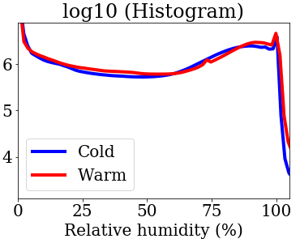
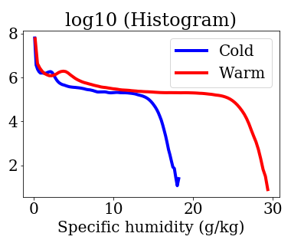
Out-of-sample (i.i.d.) ≠ Out-of-distribution
Standard ML designed to generalize well out-of-sample (val./test set)
Physics-guided ML may generalize well out-of-distribution
Notes:
Source: Beucler et al. (2021). Iid = Independ
If time: How would *you* constrain your model to make it knowledge-guided?

Slide 17
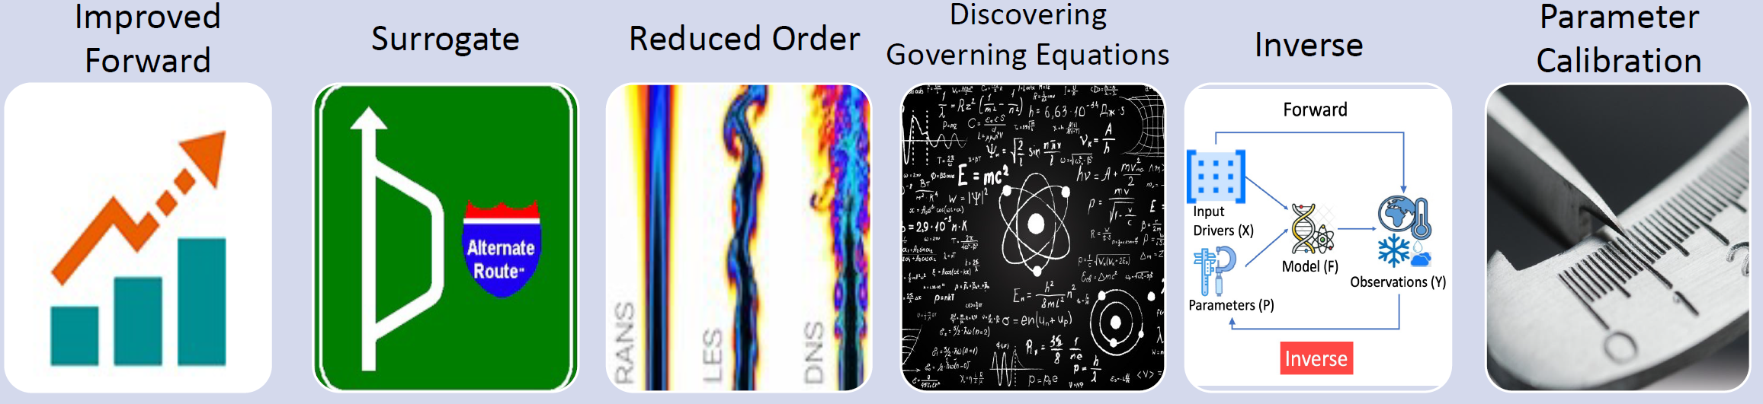
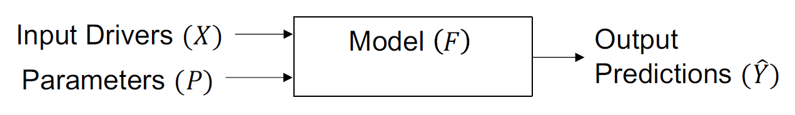
Source: Kumar et al. (2022)
Notes:
Forward modeling is the process of predicting output variables (Y) from input variables (X)
Surrogate modeling creates efficient ML models to emulate costly science-based forward models. Reduced order modeling simplifies models by capturing key dynamics in lower dimensions. Discovering governing equations identifies the laws driving a system from observations.
Inverse modeling infers latent system parameters from observations by reversing the forward model.
Parameter calibration estimates model parameters to align simulated outputs with observed data.

Slide 18
Bonus Slides
Other ways to makes the model loss or architecture knowledge-guided

Slide 19
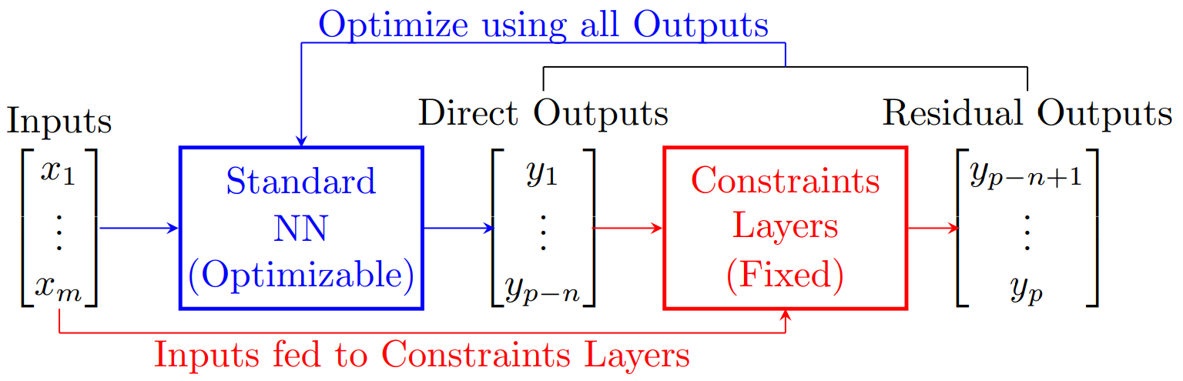
(Hard constraint) Physics-constrained architecture
Encode invariance or equivariance in architecture
Enforce physical constraints via e.g., constraints layers
See: Beucler et al. (2021), Zanetta et al. (2022)
Notes:
However, not all physical laws correspond to a straightforward invariance or equivariance, so I would like to go over a second, more *general* option: Introducing constraints layers to enforce conservation laws to machine precision. In practice, let’s start with a standard neural network mapping an input vector of length m to an output vector of total length *p*. If we have *n* constraints, instead of directly outputting *p* components, we only output *p-n* components and then calculate the remaining components as a residual of physical constraints. Now the trick is to do this calculation *within* the architecture of the neural network so that the *entire* output vector is optimized and its final weights and biases depend on the enforced physical constraints.

Slide 20
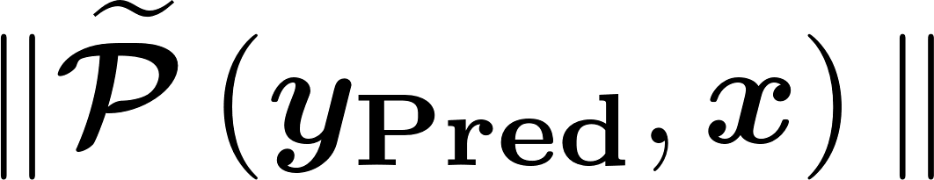
(Soft constraint) Physics-constrained loss
Physics-constrained losses:
Residual of definitions, state equations, conservation laws
Approximate dynamics
Notes:
Sometimes, we do not have exact physical constraints, in which case one can enforce approximate dynamics via the loss function, for instance to improve the algorithm’s generalization ability.

Slide 21
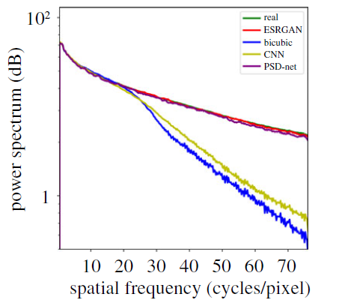
(Soft constraint) Physics-constrained loss
Physics-constrained losses:
Residual of definitions, state equations, conservation laws
Approximate dynamics
(1) Multi-scale or spectral loss; (2) directly predict spectral coefficients
See: Singh et al. (2019), Kashinath et al. (2020)
Notes:
If we know that the problem is multi-scale in nature, it may be advantageous to design a spectral loss. The first step is to calculate the spatial and/or temporal spectrum of the outputs. After that, we can design a spectral loss that guarantees a good prediction across scale, such as the log-spectral distance. An alternative is to directly target spectral coefficients rather than the full physical value of y. In the context of downscaling climate variables, Singh and coauthors showed that using a loss based on power spectral density helped them improve upon the convolutional neural network baseline.

Slide 22
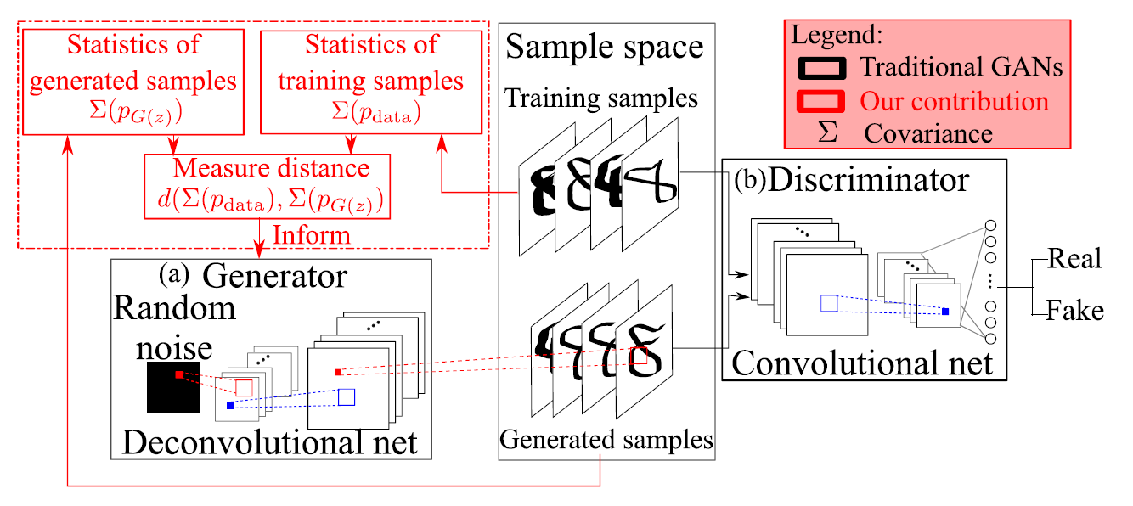
(Soft constraint) Physics-constrained loss
Physics-constrained losses:
Residual of definitions, state equations, conservation laws
Approximate dynamics
(1) Multi-scale or spectral loss; (2) directly predict spectral coefficients
Statistical constraints: (1) Compare statistical moments to truth
See: Wu et al. (2018), Mooers et al. (2020)
Notes:
If we know that statistical moments are particularly important for prediction, we can similarly constrain the neural network’s predictions by using statistical moments of the outputs in the loss function. For instance, Wu and coauthors used the covariance of the predicted flow to accelerate training and improve the representation of Rayleigh-Benard convection.

Slide 23
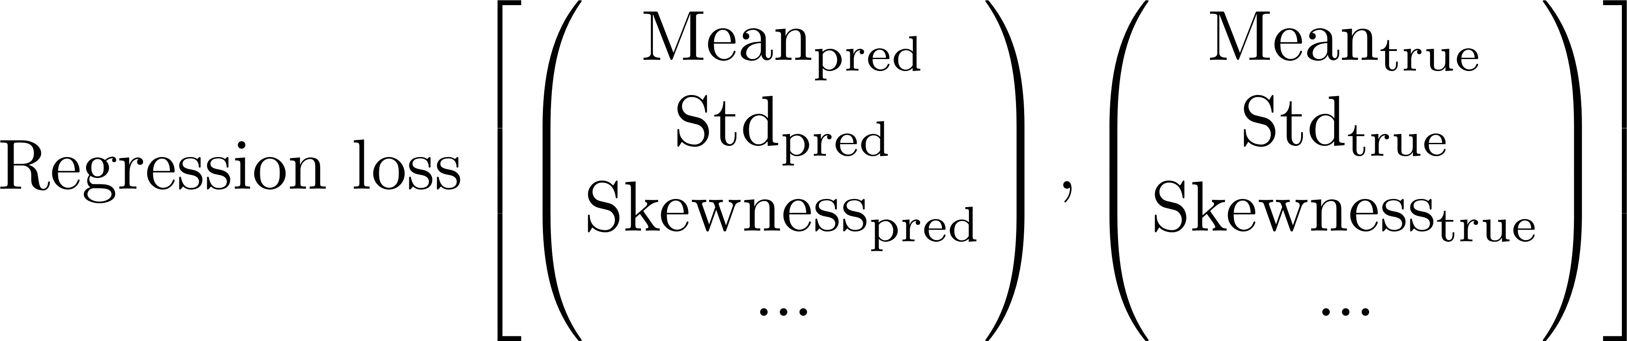
(Soft constraint) Physics-constrained loss
Physics-constrained losses:
Residual of definitions, state equations, conservation laws
Approximate dynamics
(1) Multi-scale or spectral loss; (2) directly predict spectral coefficients
Statistical constraints: (1) Compare statistical moments to truth (2) Predict moments of prescribed distributions
See: Vandal et al. (2017), Vannitsem et al. (2021), Barnes et al. (2021), Haynes et al. (2023)
Notes:
Alternatively, we can directly target the statistical moments of a prescribed distribution. For instance, Vandal and coauthors targeted the moments of a lognormal distribution to forecast precipitation, which significantly improved prediction quality given the non-Gaussian nature of precipitation. This can be generalized to target the conditional moments of any prescribed distribution as discussed in Barnes and coauthors, which gives more flexibility than predicting a single value and has the added benefit of estimating uncertainty.

Slide 24
(Soft constraint) Physics-constrained loss
Physics-constrained losses:
Residual of definitions, state equations, conservation laws
Approximate dynamics
(1) Multi-scale or spectral loss; (2) directly predict spectral coefficients
Statistical constraints: (1) Compare statistical moments to truth (2) Predict moments of prescribed distributions
Custom weighting to emphasize certain physical regimes
See: Lopez-Gomez et al. (2022)
Notes:
Finally, we can design a custom weighting schemes to give more importance to certain physical regimes. For instance, in the context of heatwave prediction, Lopez-Gomez and coauthors showed that using the mean-squared error of the prediction’s exponential led to improved representation of extremes without compromising the mean prediction.

